Slide 1



KING COUNTY
HOUSE PRICES
ANALYSIS
Regression Analysis
of house sales prices
Fabian Werkmeister

Slide 2

TOPICS
I.
BUSINESS CASE pp.3-5
II.
EXPLORATORY DATA ANALYSIS pp. 6-7
III.
REGRESSION
ANALYSIS pp. 8-9
IV. GEO MAPPING p. 10
V.
IMPLICATIONS p. 11
▢ AUDIENCE
▢ ANALYSIS OBJECTIVES
▢ DATA BASIS
▢ EXAMINE VARIABLES
▢ DEFINE FACTORS
▢ MODEL PARAMETERS
▢ ESTIMATE AND EVALUATE MODEL
▢ EXAMINE NEIGHBOURHOODS
▢ REVEAL LOCATION PATTERNS

Slide 3
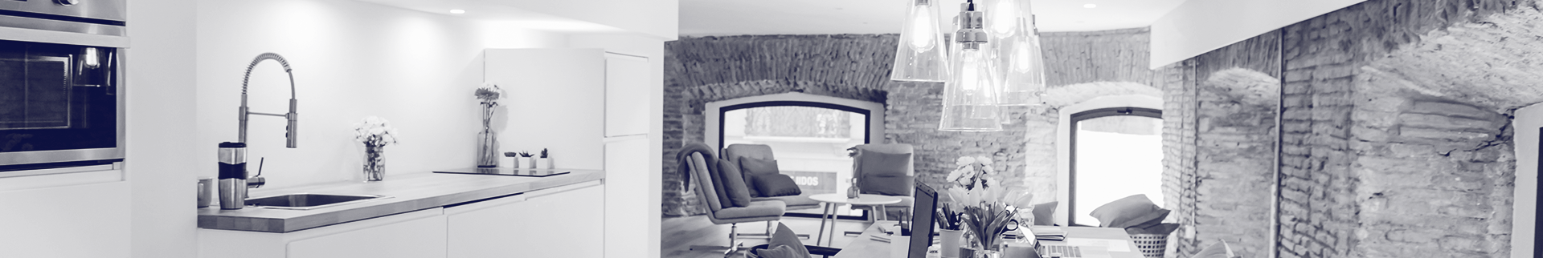
AUDIENCE
HIGH PRICE SEGMENT
DATA BASIS
DATA SCIENCE
REAL ESTATE AGENCY
Operates for years in high price segment
Not specialized in luxury listings
No exclusive network or access to VIPs/celebrities
Little to no digital documentation of customer data
Heavily dependent on expertise and knowledge of skilled realtors
Want to get to know what data science is in order to evaluate if data science can be
beneficial and/or reveal anything new to them
Propose an easy framework for sales predictions

Slide 4

ANALYSIS OBJECTIVES
FACTORS
IMPACT
LOCATION
What are the objective factors that determine sales prices in the high price real estate segment
How and to which extent do these factors contribute to sales prices
Which neighbourhoods and locations in King County should be focused on

Slide 5
DATA BASIS
HOUSE SALE PRICES
MAY 2014 - MAY 2015
KING COUNTY, WA
21.613 OBSERVATIONS

Slide 6
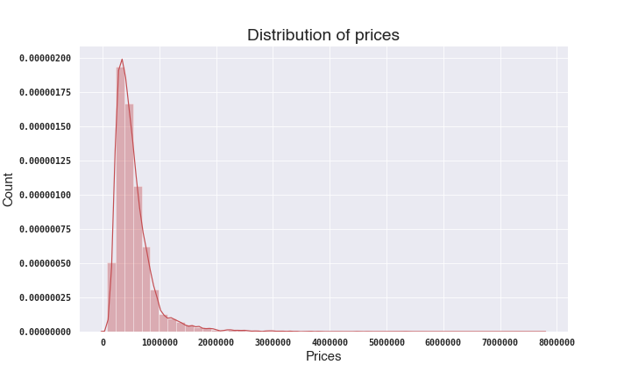
DISTRIBUTION OF PRICES
DESCRIPTIVE STATISTICS
HOUSE PRICES
Mean
Median
540.296 $
450.000 $
Minimum
Maximum
78.000 $
7.700.000 $
25 % of all prices are above
645.000 $

Slide 7
FACTORS WHICH DETERMINE THE SALES PRICE
Total area of the house in square foot
Square feet living area
Years built
Year in which house was built
Price
Number of bathrooms in house
Bathrooms
Renovated
Did house get renovated?
Price of sold house
in $
Waterfront
Quality Grade
Did house get certified a good grade of quality? (quality value >= 10, based on King County grading system¹
Does house have a waterfront view?

Slide 8
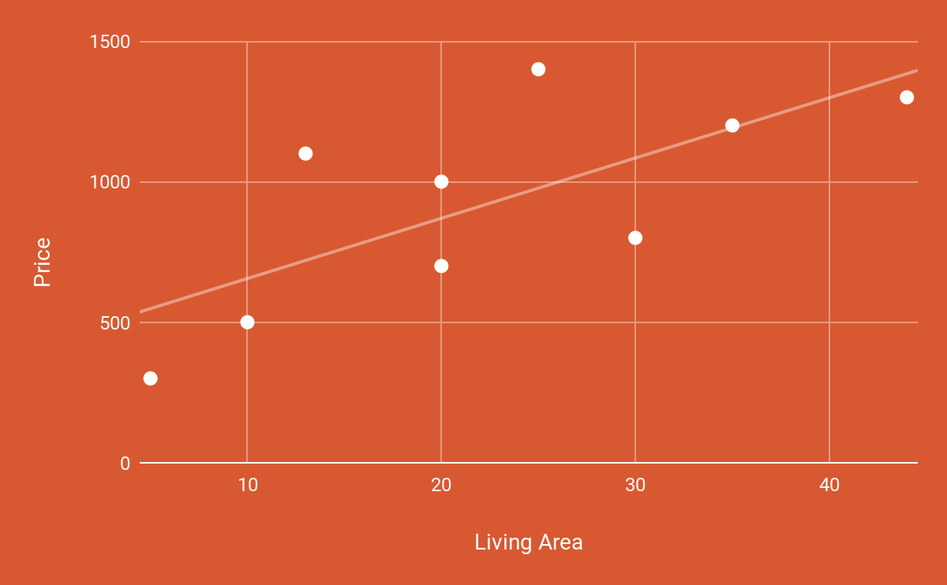
REGRESSION ANALYSIS
Linear regression quantifies the relationship between one or more predictor variables and one outcome variable.
→ is used for predictive analysis
Our case: Outcome variable = “Price”
Predictor variables = Factors (from previous slide)
Data Basis for Regression → all observations with sales prices ranging from 645.000 $ to 1.100.000 $ (that way, unusual expensive houses, which we can’t get access to will be excluded from the analysis)

Slide 9

OUTCOMES OF
MODEL ESTIMATION
EVALUATION OF MODEL
Factors increasing house sales prices
Checking for statistical significance “Does my model make sense?”
Every additional square foot of total living area of the house increases the sales price on average by 44 $
With every year going backwards from now the sales price increases on average by 619 $
Every additional bathroom in the house increases the sales price on average by 12.317 $
If the house got renovated the sales price increases on average by 55.240 $
If the house got a good quality grade the sales price increases on average by 33.747 $
If the house has got a waterfront view the sales price increases on average by 47.734 $
The overall Model is statistically significant
The model predictions deviate on average by 12% in both directions from the average sales price → in value terms approx. by +/- 100.000 $
All Factors are statistically significant, i.e. they contribute to predict the average sales price for houses

Slide 10
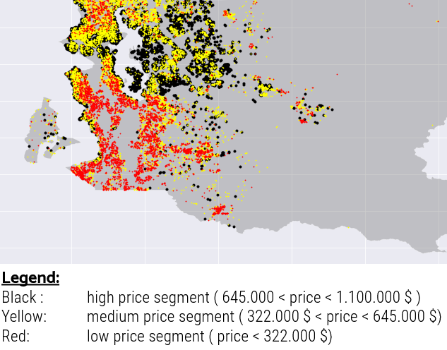
GEO-MAPPING
→ lots of houses sold in high price segment (black) are at the waterfront
→ certain areas with high average sales prices (all zipcodes in appendix²)
→ opportunity at Vashon Island
Visualization, where houses in King County have been sold to which price

Slide 11



IMPLICATIONS
Houses in your portfolio should be in a good shape and/or renovated, which also lead to a good quality grade
Houses in your portfolio should have a waterfront view
Be the first and create a new exclusive neighbourhood on Vashon Island
To sell high (derived from regression)
To sell high (derived from regression and geo-map)
New opportunity (derived from geo-map)

Slide 12
FUTURE WORK
Have a deeper look into the two “15”- variables
Categories were made to dichtotome variables. Perhaps create several dummies from these variables
Further investigation, if this could be an actual opportunity, or if neighbourhood isn’t that promising
Variables weren’t considered
Detailed feature engineering
Vashon Island

Slide 13

THANK
YOU!

Slide 14
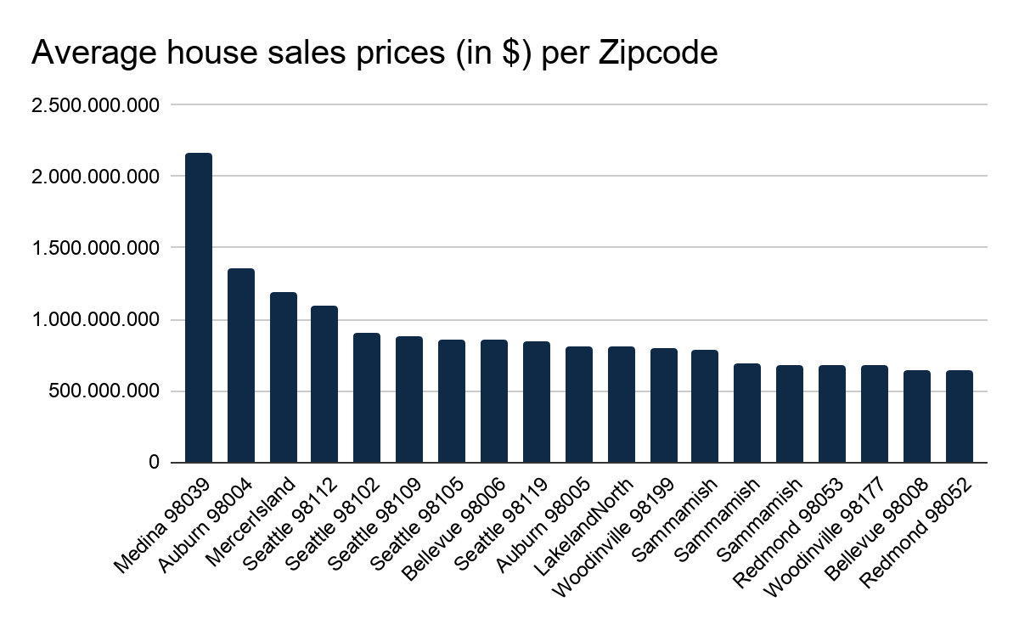
Appendix
1: https://info.kingcounty.gov/assessor/esales/Glossary.aspx?type=r#g → under “GRADE”
2:

